Slide 1
Machine Learning Disease Detection
Sahil Motwani (21BRS1162)
Shyam Sundhar (21BRS1179)
Dev Rastogi (21BRS1178)
Anishek AM (21BRS1286)

Slide 2
AGENDA
Introduction to Disease Detection
Problem Statement
Literature Survey Highlights
Proposed Methodology
Kidney and Liver Disease Prediction
Heart and Breast Cancer Predictions
Results and Performance Analysis
Conclusion and Future Directions

Slide 3
Introduction to Disease Detection
Machine learning has emerged as a transformative technology in the healthcare sector, particularly in the realm of disease detection. By analyzing vast amounts of medical data, machine learning algorithms can identify patterns and predict the likelihood of diseases such as kidney ailments, liver disorders, heart diseases, and breast cancer. These advanced techniques enhance diagnostic accuracy, facilitate early intervention, and ultimately improve patient outcomes, reshaping traditional approaches to disease management.

Slide 4
Problem Statement
Limitations of Traditional Diagnostic Methods
Need for Efficient Multi-Disease Detection Systems
Rely heavily on subjective clinical observations, leading to variability in diagnosis.
Time-consuming laboratory tests often delay diagnosis and treatment.
Error-prone medical imaging can result in misdiagnoses and patient anxiety.
Machine learning can analyze vast datasets quickly and accurately.
Integration of patient data from various sources enhances diagnostic capability.
Proactive disease detection systems can improve patient outcomes through timely interventions.

Slide 5
Literature Survey Highlights
Kidney Disease Detection
Chronic Kidney Disease Insights
Heart Disease Prediction Advances
Dasgupta et al. (2023) explored machine learning techniques for early kidney disease detection, emphasizing feature selection's role in improving diagnostic accuracy. Their findings highlighted the potential for advanced models to enhance clinical decision-making.
Kalantar-Zadeh et al. (2021) reviewed chronic kidney disease, discussing its epidemiology and risk factors. They emphasized the importance of interdisciplinary approaches to improve management strategies, integrating machine learning into clinical practice.
Soni et al. (2011) demonstrated the effectiveness of machine learning in identifying risk factors for heart disease, showcasing various algorithms that enhance predictive accuracy. Their work supports the integration of predictive analytics in healthcare.

Slide 6
Proposed Methodology
Data Collection
Data Preprocessing
Model Training and Evaluation
Deployment and Monitoring
Gather datasets that include clinical records, medical imaging, and lab results for kidney disease, liver disorders, heart disease, and breast cancer.
Clean datasets by handling missing values, encoding categories, and normalizing features to prepare for analysis.
Train various machine learning algorithms and evaluate performance using accuracy, sensitivity, and F1 score to select the best model for each disease.
Implement selected models in clinical settings for real-time predictions and establish monitoring to assess performance and update with new data.
Dataset of clinical records
Collection of medical images
Laboratory test results
Cleaned dataset ready for analysis
Encoded categorical features
Normalized numerical features
Trained predictive models
Evaluation metrics report
Selected best models for each disease
Deployed predictive model
Monitoring system for model performance
Regular updates and maintenance plan

Slide 7

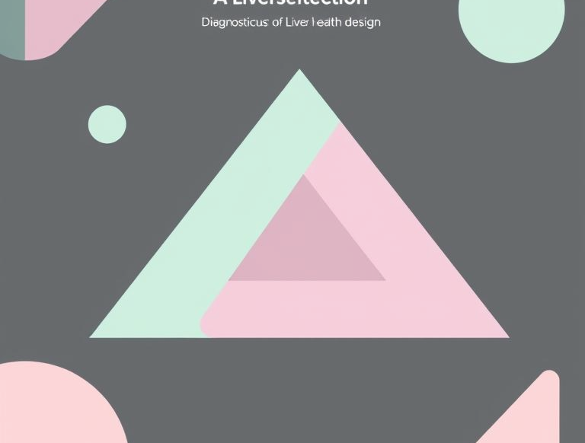
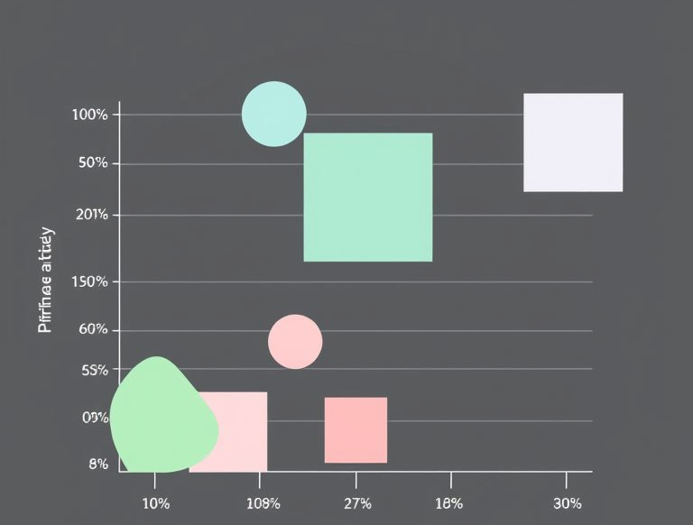
Kidney and Liver Disease Prediction
Kidney Disease Prediction Methodology
Utilized a dataset of clinical and laboratory features, employing Random Forest Classifier which achieved an accuracy of 99% in predictions.
Liver Disease Prediction Methodology
Applied Support Vector Machine (SVM) on clinical data, obtaining an accuracy of 71% which indicates the need for further improvements.
Performance Metrics Overview
Compiling results, the Random Forest model for kidney disease reported high precision and recall, while SVM for liver disease highlighted areas needing enhancement.

Slide 8


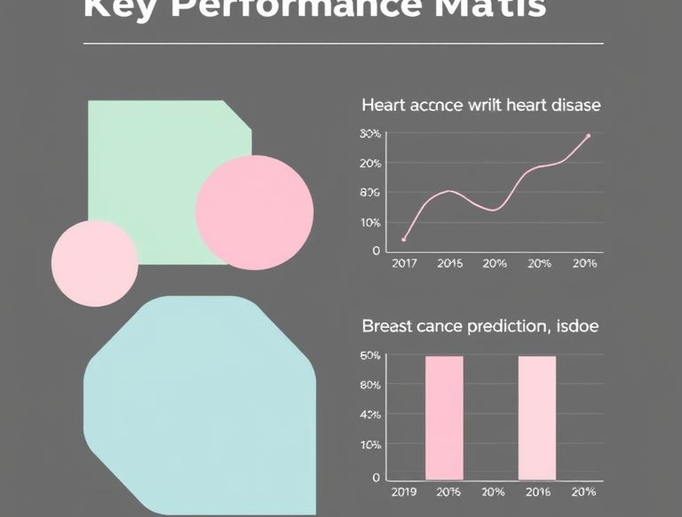
Heart and Breast Cancer Predictions
Heart Disease Methodology
Utilized Random Forest and XGBoost algorithms for analysis on clinical dataset, achieving 99% accuracy in predictions.
Breast Cancer Methodology
Employed Support Vector Machines (SVM) with feature selection techniques, yielding 96% accuracy and 98% recall rates.
Key Performance Metrics
Heart disease prediction accuracy: 99%, Breast cancer prediction accuracy: 96%. Both models demonstrated high precision and recall rates.

Slide 9
Results and Performance Analysis
99.16%
Kidney Disease Accuracy
88%
Heart Disease Accuracy
96%
Breast Cancer Accuracy
88.45%
Liver Disease Accuracy

Slide 10
Conclusion and Future Directions
The study on multi-disease detection utilizing machine learning techniques has demonstrated significant advancements in predictive accuracy for kidney disease, heart disease, liver disorders, and breast cancer. High accuracy rates, especially with Random Forest and Gradient Boosting algorithms, indicate the potential of these models in clinical settings.
Future research should focus on enhancing model robustness by integrating larger and more diverse datasets, incorporating real-time data from wearable devices, and exploring advanced techniques such as deep learning for better generalization across populations. Additionally, addressing privacy concerns and ensuring the interoperability of systems will be crucial for the practical application of these technologies in healthcare environments.

Slide 11
Thank you.

